Slide 1
Different Crash Recovery Methods
Shadow Paging
Log-Based Recovery
Buffer Management
Remote Backup System

Slide 2
Shadow Paging
Shadow paging is a recovery method for retrieving data in DBMS.
The main use of this technique is maintaining the consistency in data if failure happens in any case.
The technique is also known with the name of Cut of Place Updating.
There is no need to log in to a single user environment while performing this technique. However, the system needs a log for concurrency control during the multiuser environment.

Slide 3
Shadow Paging
It offers durability and atomicity to the system in the entire process.
This concept utilizes quite a few disks for completing the operation.
It is known to give power to manipulating pages in a database that is a very important step to perform.
If we talk about the single-user environment, the recovery scheme never asks for the log.
When we perform shadow paging in a multiuser environment, here will be strongly a requirement for a log as it involves a concurrency control procedure.

Slide 4
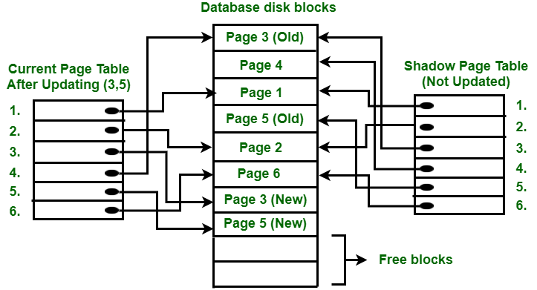
In below fig., two write operations are performed on page 3 and 5. Before start of write operation on page 3, current page table points to old page 3. When write operation starts following steps are performed :
Firstly, search start for available free block in disk blocks.
After finding free block, it copies page 3 to free block which is represented by Page 3 (New).
Now current page table points to Page 3 (New) on disk but shadow page table points to old page 3 because it is not modified.
The changes are now propagated to Page 3 (New) which is pointed by current page table.

Slide 5
Log-Based Recovery
Atomicity property of DBMS states that either all the operations of transactions must be performed or none.
The modifications done by an aborted transaction should not be visible to database and the modifications done by committed transaction should be visible.
To achieve goal of atomicity, user must first output to stable storage information describing the modifications, without modifying the database itself.
The log is a sequence of log records, recording all the update activities in the database. In a stable storage, logs for each transaction are maintained. Any operation which is performed on the database is recorded is on the log.

Slide 6
Log-Based Recovery
An update log record represented as: <Ti, Xj, V1, V2> has these fields:
Transaction identifier: Unique Identifier of the transaction that performed the write operation.
Data item: Unique identifier of the data item written.
Old value: Value of data item prior to write.
New value: Value of data item after write operation.
Other type of log records are:
<Ti start>: It contains information about when a transaction Ti starts.
<Ti commit>: It contains information about when a transaction Ti commits.
<Ti abort>: It contains information about when a transaction Ti aborts.

Slide 7
Recovery using Log records
After a system crash has occurred, the system consults the log to determine which transactions need to be redone and which need to be undone.
Transaction Ti needs to be undone if the log contains the record <Ti start> but does not contain either the record <Ti commit> or the record <Ti abort>.
Transaction Ti needs to be redone if log contains record <Ti start> and either the record <Ti commit> or the record <Ti abort>.

Slide 8
Buffer Management Recovery System
A database buffer is a temporary storage area in the main memory. It allows storing the data temporarily when moving from one place to another. A database buffer stores a copy of disk blocks. But, the version of block copies on the disk may be older than the version in the buffer.
A Buffer Manager is responsible for allocating space to the buffer in order to store data into the buffer.
If a user request a particular block and the block is available in the buffer, the buffer manager provides the block address in the main memory.
If the block is not available in the buffer, the buffer manager allocates the block in the buffer.
If free space is not available, it throws out some existing blocks from the buffer to allocate the required space for the new block.
The blocks which are thrown are written back to the disk only if they are recently modified when writing on the disk.
If the user requests such thrown-out blocks, the buffer manager reads the requested block from the disk to the buffer and then passes the address of the requested block to the user in the main memory.
However, the internal actions of the buffer manager are not visible to the programs that may create any problem in disk-block requests. The buffer manager is just like a virtual machine.

Slide 9
Buffer Management Recovery System
For serving the database system in the best possible way, the buffer manager uses the following methods:
Buffer Replacement Strategy: If no space is left in the buffer, it is required to remove an existing block from the buffer before allocating the new one. The various operating system uses the LRU (least recently used) scheme.
Pinned Blocks: If the user wants to recover any database system from the crashes, it is essential to restrict the time when a block is written back to the disk. In fact, most recovery systems do not allow the blocks to be written on the disk if the block updation being in progress. Such types of blocks that are not allowed to be written on the disk are known as pinned blocks.
Forced Output of Blocks: In some cases, it becomes necessary to write the block back to the disk even though the space occupied by the block in the buffer is not required. When such type of write is required, it is known as the forced output of a block.

Slide 10
Remote Backup Recovery System
Remote backup systems provide a wide range of availability, allowing the transaction processing to continue even if the primary site is destroyed by a fire, flood or earthquake.
Data and log records from a primary site are continuously backed up into a remote backup site.
One can achieve ‘wide range availability’ of data by performing transaction processing at one site, called the ‘primary site’, and having a ‘remote backup’ site where all the data from the primary site are duplicated.
The remote site is also called ‘secondary site’.
The remote site must be synchronized with the primary site, as updates are performed at the primary.

Slide 11
Remote Backup Recovery System
In designing a remote backup system, the following points are important:
Detection of failure: It is important for the remote backup system to detect when the primary has failed.
Transfer of control: When the primary site fails, the backup site takes over the processing and becomes the new primary site.
Time to recover: If the log at the remote backup becomes large, recovery will take a long time.
Time to commit: To ensure that the updates of a committed transaction are durable, a transaction should not be announced committed until its log records have reached the backup site.

